Slide 1


Introduction to Operating Systems CS 1550
Spring 2023
Sherif Khattab
ksm73@pitt.edu
(Some slides are from Silberschatz, Galvin and Gagne ©2013)

Slide 2
Course Goal and Objectives
Continue to demystify a good portion of the magic about how computers work so that you can write more efficient programs
The specific objectives are:
Modify and compile the Linux kernel to add system calls
Write multi-process/multi-thread programs free from race conditions and deadlocks
Simulate page-replacement algorithms for virtual memory management
Implement a user-land file system

Slide 3
Contact Info
Course website: http://www.cs.pitt.edu/~skhattab/cs1550/
Instructor: Sherif Khattab ksm73@pitt.edu
Student Support Hours: https://khattab.youcanbook.me
MW: 11:00-12:00
Th: 9:00-10:00 and 11:00-12:00
F: by appointment
6307 Sennott Square, Virtual Office: https://pitt.zoom.us/my/khattab
Teaching Team:
TBD
Recitations start next week!
Communication
Piazza (Please expect a response within 72 hours)
Email not recommended!

Slide 4
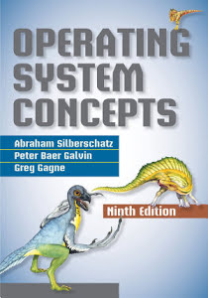
Textbook
Operating System Concepts (9th Edition)
Silberschatz, Galvin, and Gagne

Slide 5
Grading
40% on four programming projects
System programming using C
posted on Canvas, distributed using Github, and submitted on Gradescope from Github
partially auto-graded with unlimited submission attempts
30% on exams: 18% on higher grade and 12% on lower
10% on homework assignments on Canvas
auto-graded with three attempts
10% on lab exercises and 4 quizzes on the projects; auto-graded
Labs use MIT’s Xv6 operating system
10% on in-class Top Hat questions
participation only

Slide 6
Canvas Walkthrough
Lecture PPTs posted on Tophat after class
Draft slides in PDF available on Github usually before class
Lecture and recitation recordings
under Panopto Video
Pre- and Post-course test
Pre-test must be taken to unlock the course modules
Piazza for discussion and communication
Gradescope and autograding policies
Academic Integrity
NameCoach

Slide 7
Expectations
Your continuous feedback is important!
Anonymous Qualtrics survey (link on Syllabus page)
Midterm and Final OMET
Your engagement is valued and expected with
classmates
teaching team
course material

Slide 8
Lecture structure (mostly)
Time | Description
~5 min before and after class | Informal chat
~25 min | Announcements, review of muddiest points on previous lecture, and QA on assignments/labs/homework problems
~45 min | Lecturing with Tophat questions and/or activities
~5 minutes | QA and muddiest points/reflections

Slide 9
Why is this class (notoriously) hard?
Lots of concepts
Attend lectures and recitations (if you absolutely cannot attend in-person, watch the video recordings)
Study often!
Put effort into the weekly homework assignments
Projects are relatively hard
Refresh your C programming and GDB debugging skills (CS 0449!)
Start early and show up to student support hours!

Slide 10
Announcements
Lab 0 due next Friday (soft deadline; not graded)
Homework 1 will be posted this Friday
Recitations start next week
VS Code setup tutorial on Piazza (also linked from Canvas)
Draft Slides linked from Canvas

Slide 11
Agenda
Main tasks of an operating system
System Calls
What an interrupt is
What happens when an interrupt occurs
What a system call is
How system calls implemented
Effect of OS structure on system calls

Slide 12
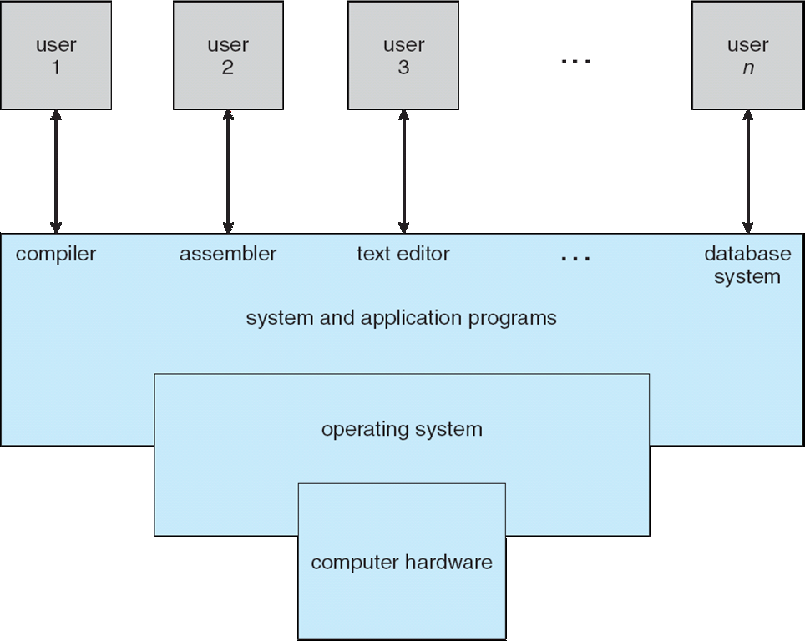
What is an Operating System?
A program that acts as an intermediary between a user of a computer and the computer hardware

Slide 13
What does an OS do?
Manages (controls and arbitrates) resources
Processors, Memory, Input/output devices, Communication devices, Storage, Software applications
Conflicting goals:
e.g., performance vs. utilization
Separation of policy and mechansim
Provides abstractions to application programs
Ease of use
Virtualization
Protects resources

Slide 14
Interrupts
Hardware or software:
Hardware interrupt by one of the devices
Software interrupt (exception or trap):
Software error (e.g., division by zero)
Other process problems include processes trying to modify each other’s or the operating system’s memory (e.g., segmentation fault)
Request for operating system service (i.e., system call)

Slide 15
Interrupt Descriptor Table
Interrupt transfers control to the interrupt service routine (ISR)
ISRs are segments of code that determine what action should be taken for each type of interrupt
part of the OS kernel
An interrupt vector contains the address of the ISR for one interrupt
An interrupt vector table is an array of interrupt vectors
also known as interrupt descriptor table (IDT)

Slide 16
Dual-mode Operation
Dual-mode operation allows OS to protect itself and other system components
At least two modes: user mode and kernel mode
Mode bit(s) provided by hardware (inside CPU registers)
Provides ability to distinguish when system is running user code or kernel code
Some instructions designated as privileged, only executable in kernel mode
Some memory addresses designated as privileged, only accessible in kernel mode
Therefore, we get segmentation fault on null (i.e., 0) pointer dereference
Interrupts change mode to kernel
return from interrupt resets mode back to user
Increasingly CPUs support multi-mode operations
virtual machine manager (VMM) mode for guest VMs

Slide 17
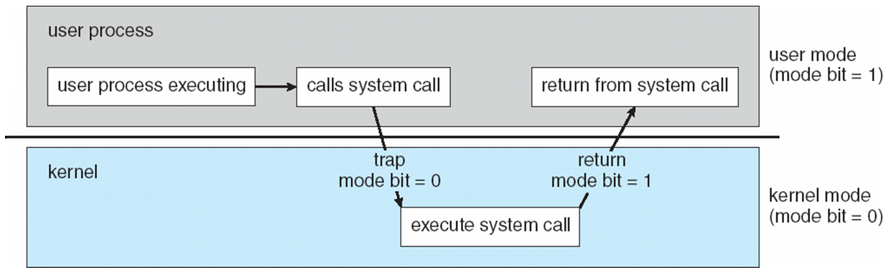
What happens when an interrupt occurs?
The CPU transitions from User Mode to Kernel Mode
an interrupt
occurs
return from ISR
execute ISR
Time

Slide 18
How does an OS (roughly) work?

Slide 19
What happens on a hardware interrupt?
6
1
4
7
5
9
2
3
8

